Slide 1




Folders and Saving Files
Year 3 · Make a folder. Save your work.
Notes:
Lesson (45-60 min): pupils make a folder named with their name and class year, create a Word document and save it inside that folder. Assumes Windows computers with File Explorer and Microsoft Word. If your school uses a different system or a network drive, adapt the location (Documents or the Year 3 shared folder) and tell pupils exactly where to make their folder.

Slide 2



Today you will…
Make a folder
Make a Word document
Save it in your folder
and name it with your name and class
type a few sentences
so you can find it again
Notes:
2 min. Explain the three jobs and that everyone ends with a folder containing a document, so the teacher can find each pupil's work.

Slide 3
What is a folder?
A FOLDER
A FILE
is like a box that keeps your files together.
is your work, such as a Word document.
Notes:
3 min. Use a real-life link: a folder is like a school bag section or a drawer; files go inside. Ask: where do we keep paper work at school? Why is it important to keep files in the right place?

Slide 4



Name your folder
Your name + your class
Sara Year 3
Use letters and numbers
No symbols
Check your spelling
Ahmed Year 3A
/ \ : * ? " < > |
Ask a partner to check
Notes:
3 min. Agree the exact format with the class: first name + Year 3 (add the class letter if you have several, e.g. "Sara Year 3A"). Windows does not allow the symbols shown. Consistent names make folders easy to find and sort.

Slide 5
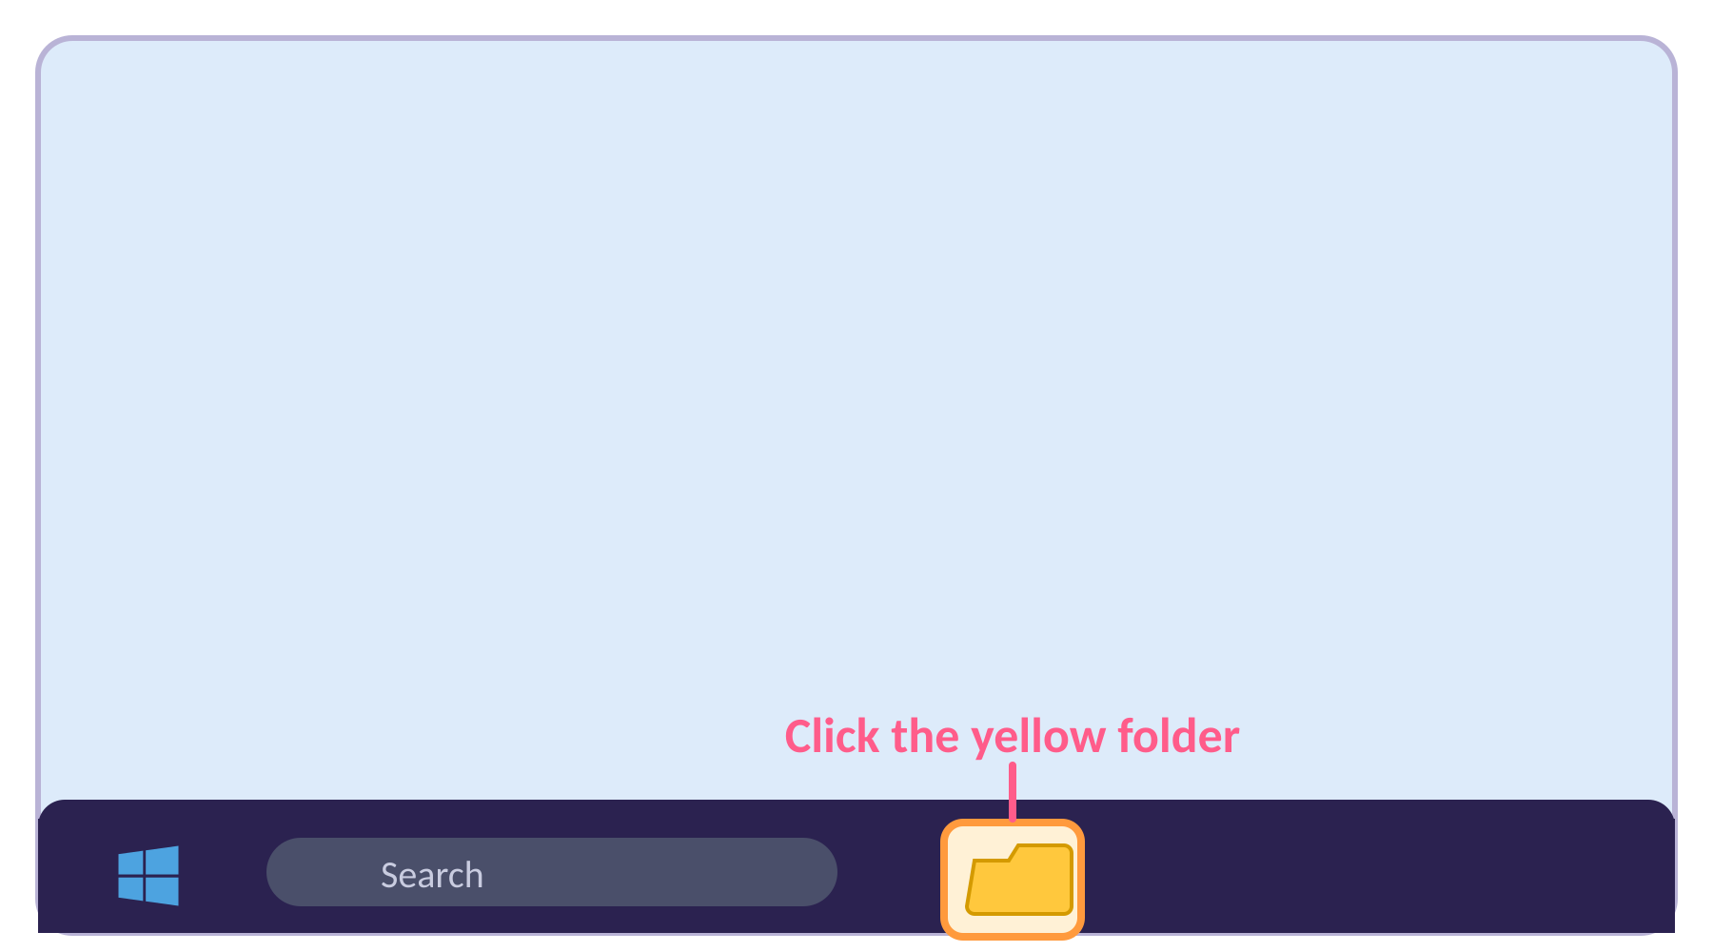
Step 1: Open File Explorer
1
Click the yellow folder icon on the taskbar
It is at the bottom of the screen.
Shortcut: hold the Windows key and press E.
Notes:
4 min total for steps 1-2. Model on the board. On some computers File Explorer may be pinned elsewhere; show the Start button search as a backup (type File Explorer).

Slide 6
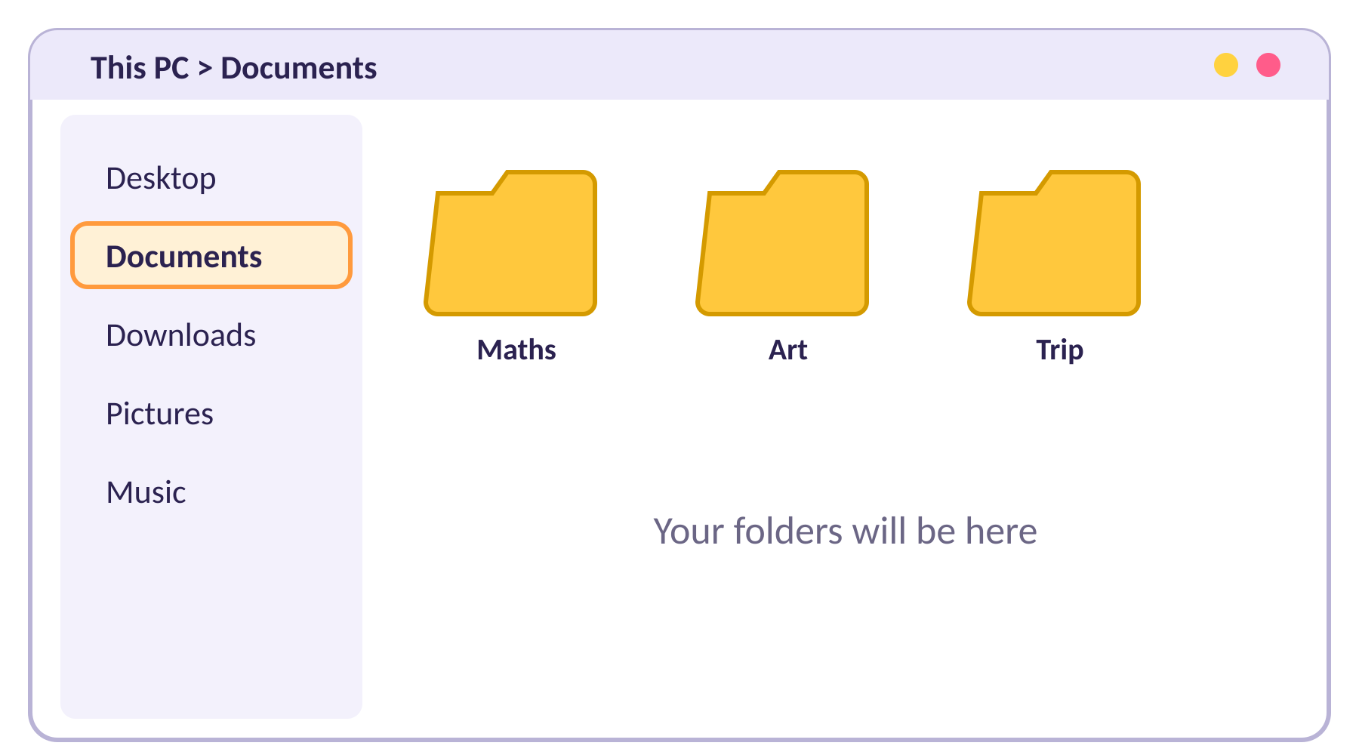
Step 2: Go to Documents
2
Click Documents on the left side.
This is where we will make your folder.
Notes:
Check everyone is in the same place. If your school uses a shared drive, tell pupils to open it instead.

Slide 7
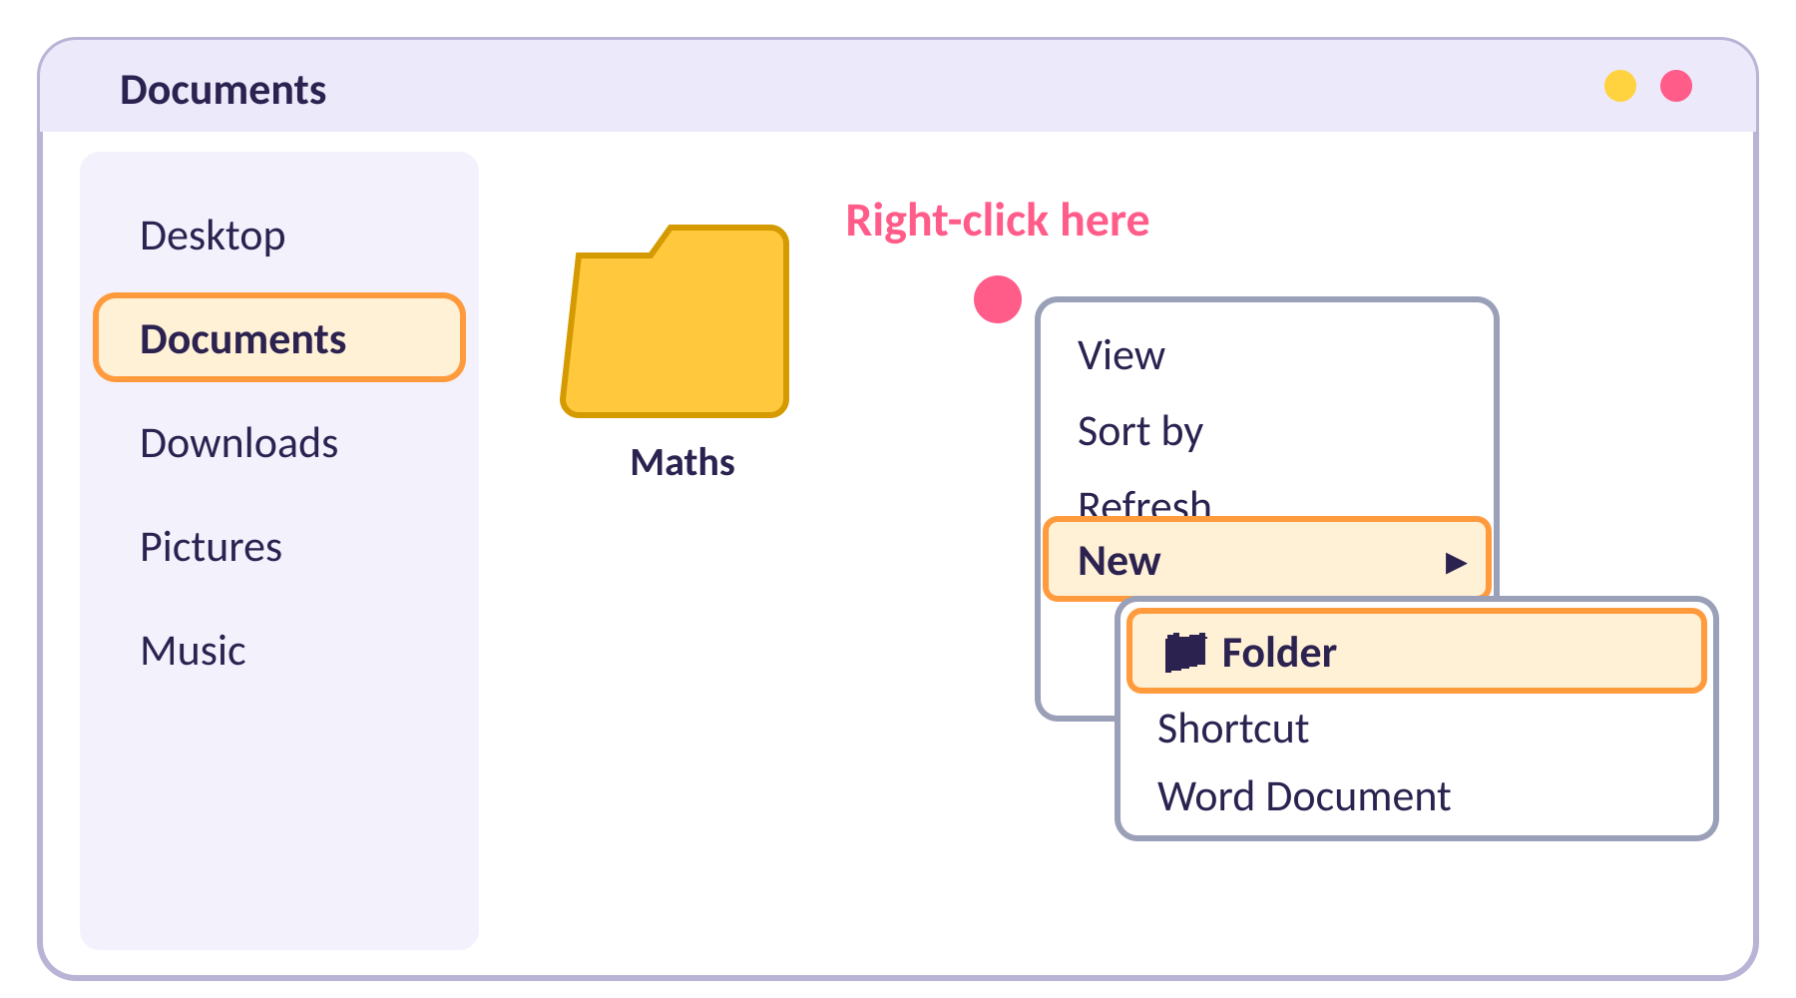
Step 3: Right-click a space
3
Right-click an empty space in the window.
Point to New.
Click Folder.
Notes:
Right-click = press the right button on the mouse (or two-finger tap on a trackpad). Pupils must click on an empty space, not on an existing folder.

Slide 8
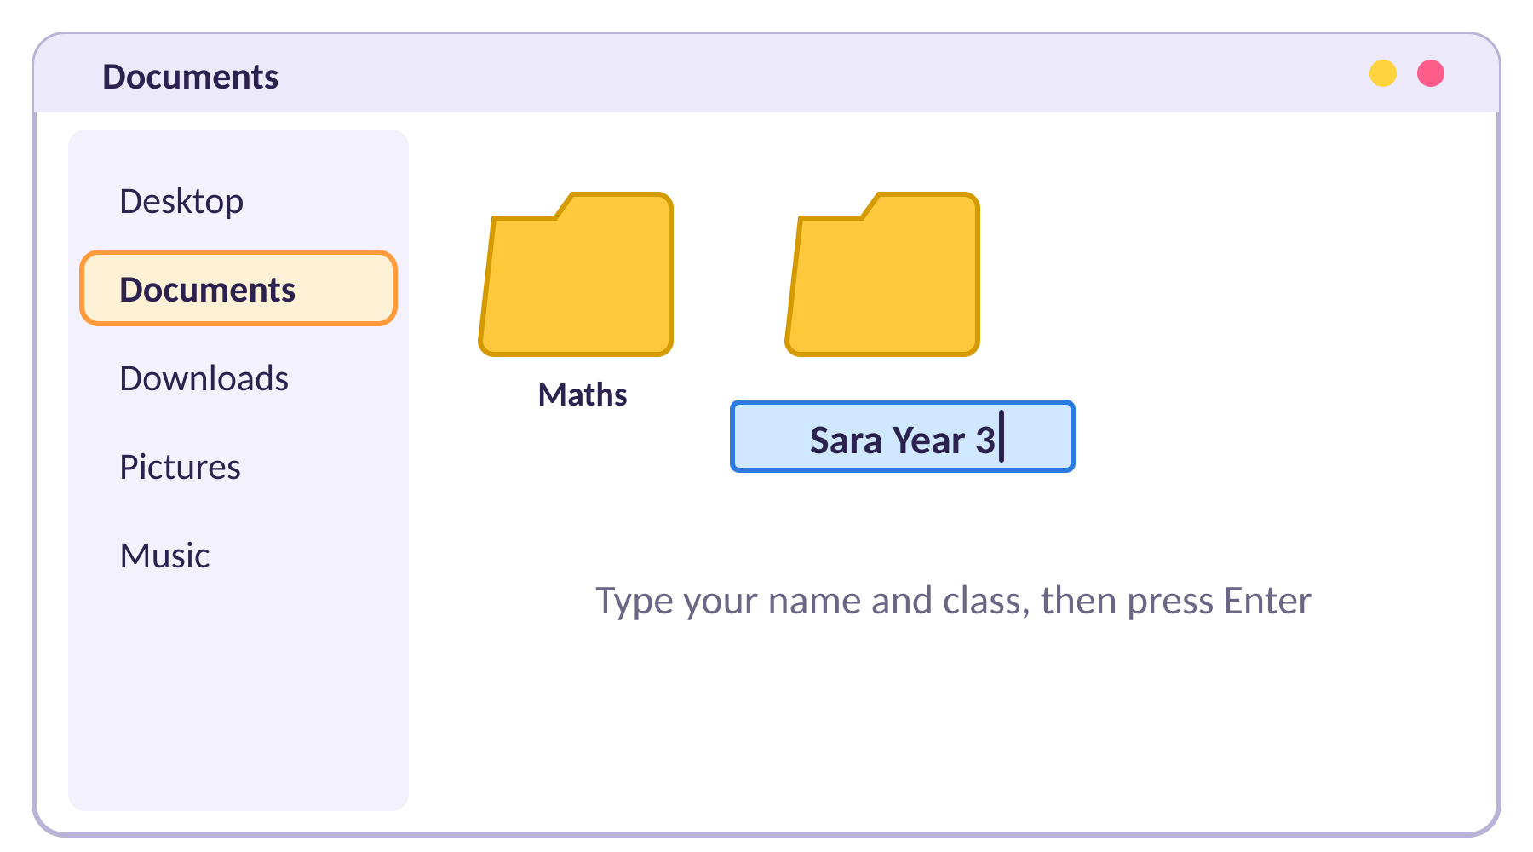
Step 4: Type the name
4
The folder name is blue and ready.
Type your name and class, for example Sara Year 3.
Press Enter.
Notes:
If a pupil clicks away before typing, the folder is called "New folder". Show them how to rename it: right-click it, choose Rename (or click it and press F2), type the name, press Enter.

Slide 9
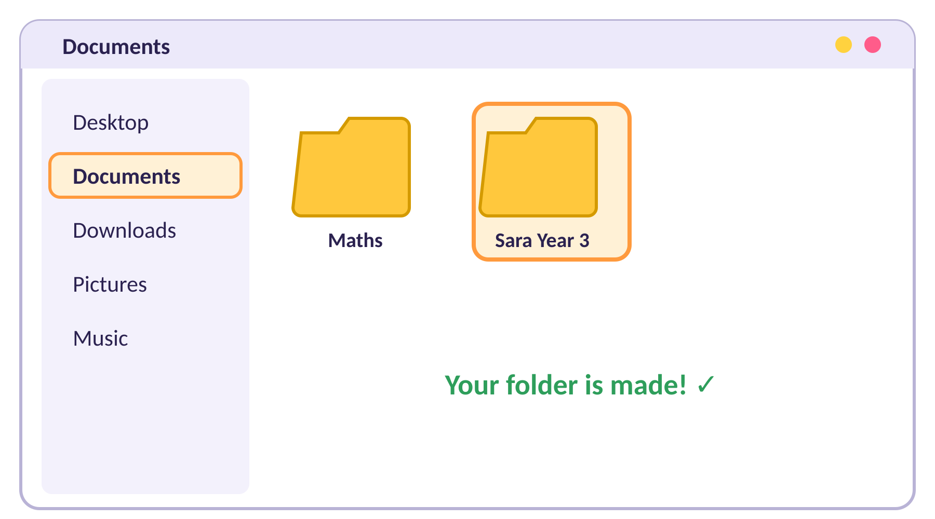
Step 5: Check your folder
5
Can you see your folder?
Is the name right?
Put your thumb up when you are ready.
Notes:
Walk round and check names. Ask pupils to read their folder name aloud to a partner.

Slide 10
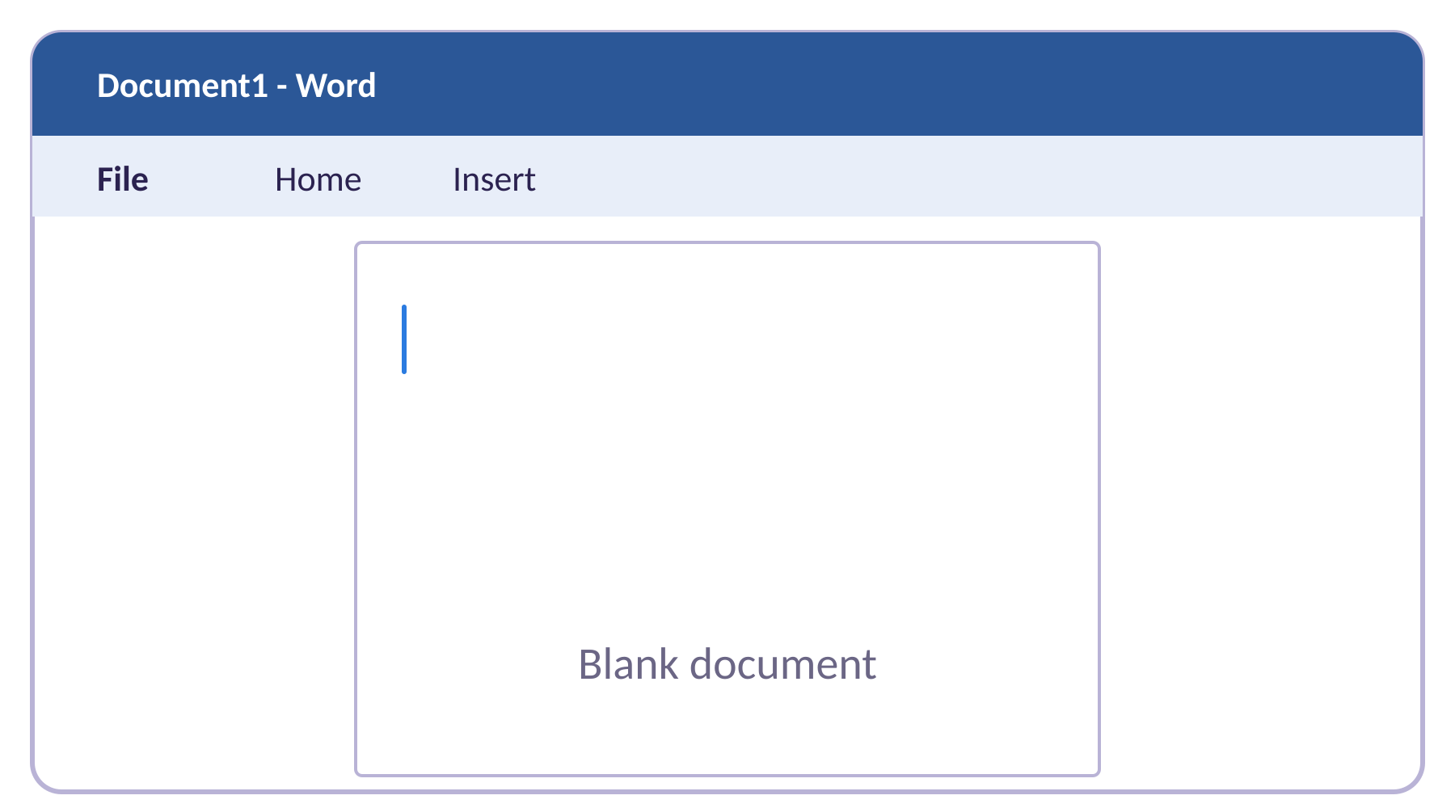
Step 6: Open Microsoft Word
6
Click the Start button, type Word and open Microsoft Word.
Choose Blank document.
Notes:
4 min. Start button is the Windows symbol bottom-left. If Word opens on a start screen, click Blank document.

Slide 11
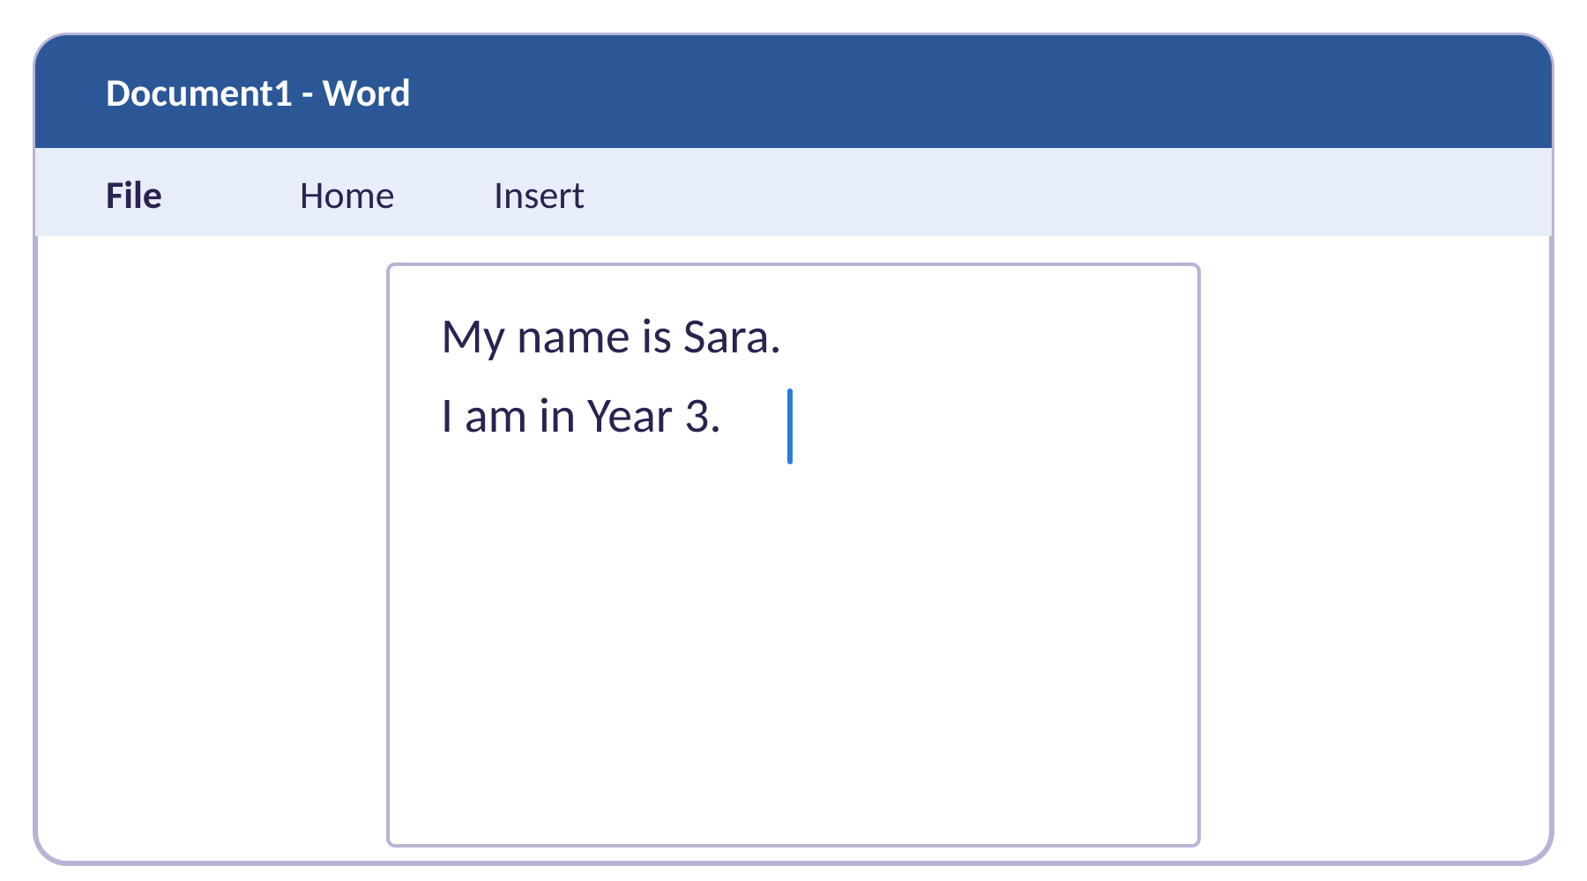
Step 7: Type about you
7
Type two sentences.
My name is …
I am in Year 3.
Notes:
Pupils type their own sentences. Fast finishers add what they like to do or a favourite subject. Do not worry about formatting yet.

Slide 12
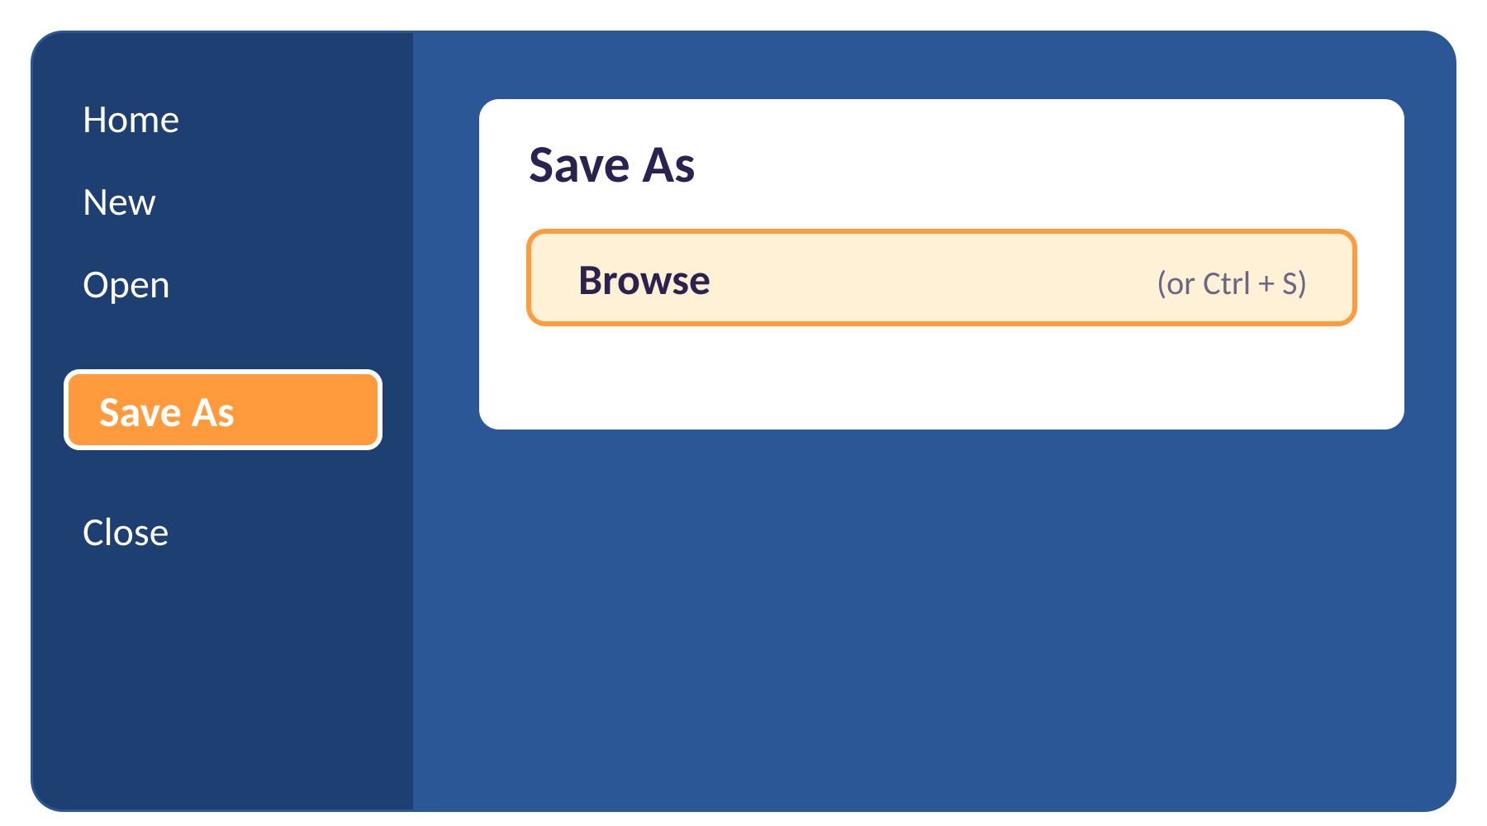
Step 8: File, then Save As
8
Click File (top left).
Click Save As.
Click Browse.
Shortcut: Ctrl + S.
Notes:
5 min. Some versions of Word show Save a Copy instead of Save As; the steps are the same. Pupils must press Browse so they can pick the folder themselves.

Slide 13
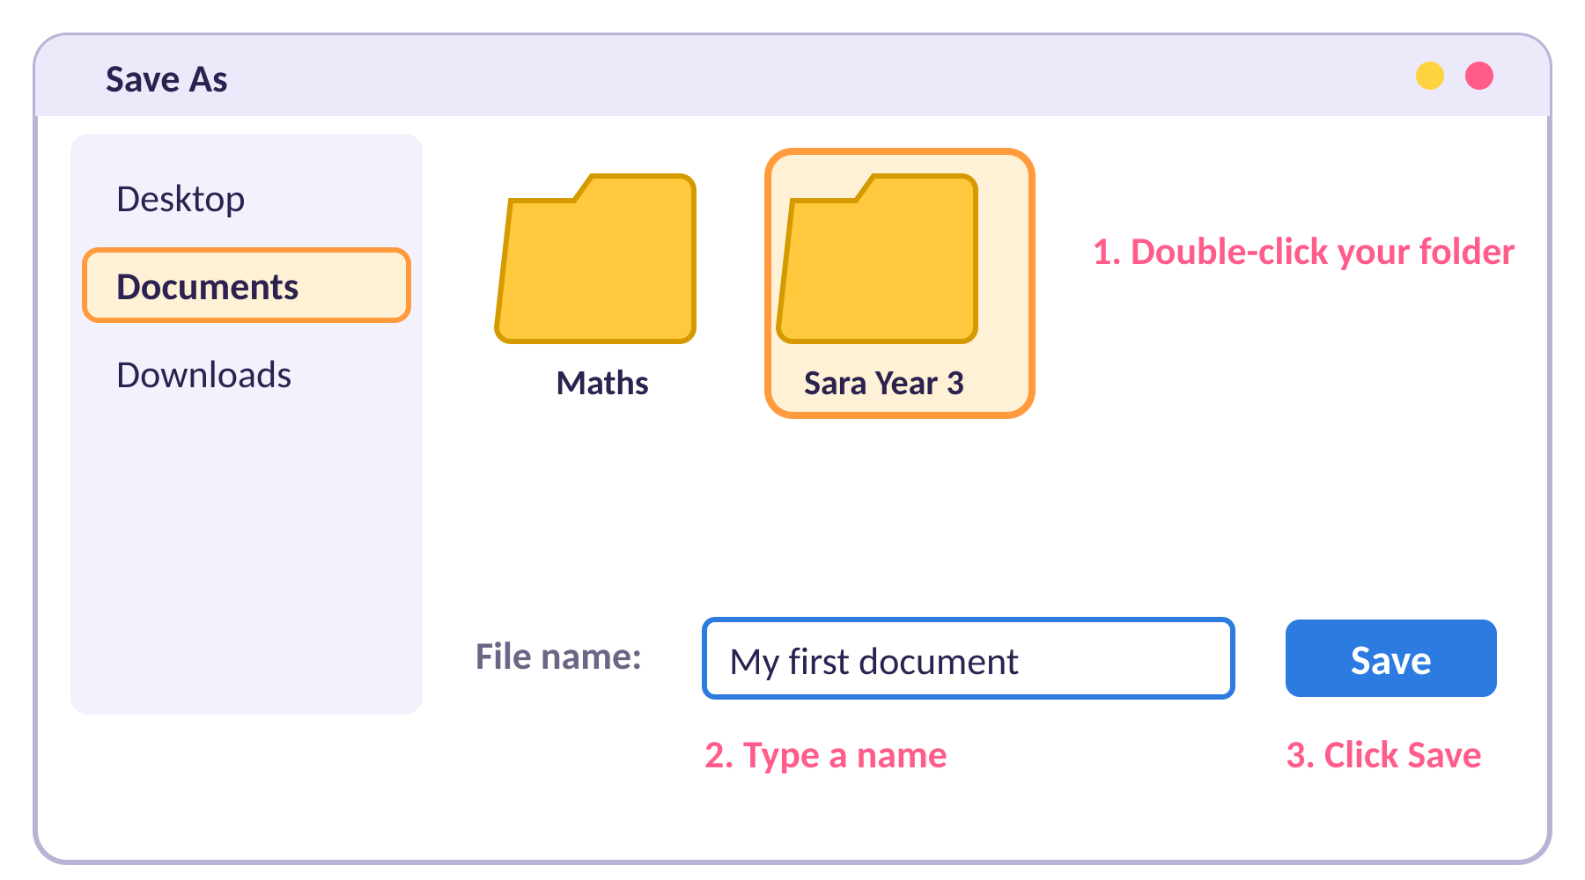
Step 9: Choose your folder
9
Click Documents on the left.
Double-click YOUR folder.
Type a file name, such as My first document.
Click Save.
Notes:
This is the key step. Check pupils open their own folder (the title bar at the top of the window shows the path) before pressing Save. Common mistake: saving into Documents instead of inside the folder.

Slide 14
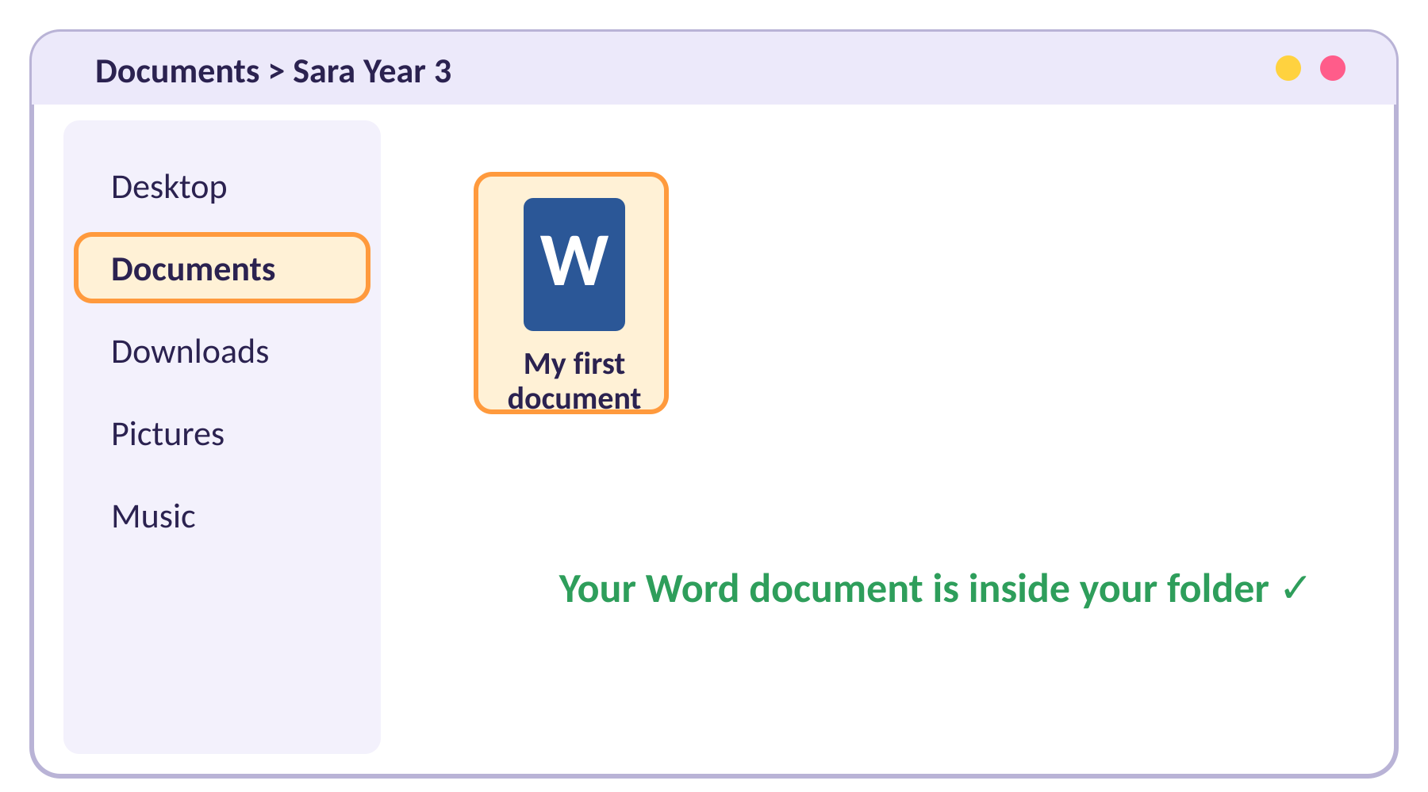
Step 10: Check it is saved
10
Open File Explorer.
Open your folder.
Is your Word document inside?
Notes:
3 min. Pupils close Word, open their folder in File Explorer and double-click the document to prove it was saved. This is the success check for the lesson.

Slide 15




Oops! What if…
I cannot find my file
I saved in the wrong place
Open File Explorer and look in your folder. Ask for help!
Open Save As again and choose your folder this time.
I spelled my folder wrong
My folder is called "New folder"
Right-click it, choose Rename, type it again.
Right-click it, choose Rename, then type your name and class.
Notes:
Keep this slide up during independent work. Encourage pupils to try the fix, then ask a partner, then ask the teacher.

Slide 16


I can…
I can make a new folder
I can name my folder with my name and class
I can create a Word document
I can save my file inside my folder
I can find my file again
Notes:
3 min. Thumbs up, sideways or down. Collect folder names as evidence, or check a few folders on pupils' screens.

